Slide 1



Cansu Guzel
EV CHARGING PATTERN

Slide 2







EV CHARGING STATIONS
CHICAGO
HOUSTON
LOS ANGELES
NEW YORK
SAN FRANCISCO

Slide 3
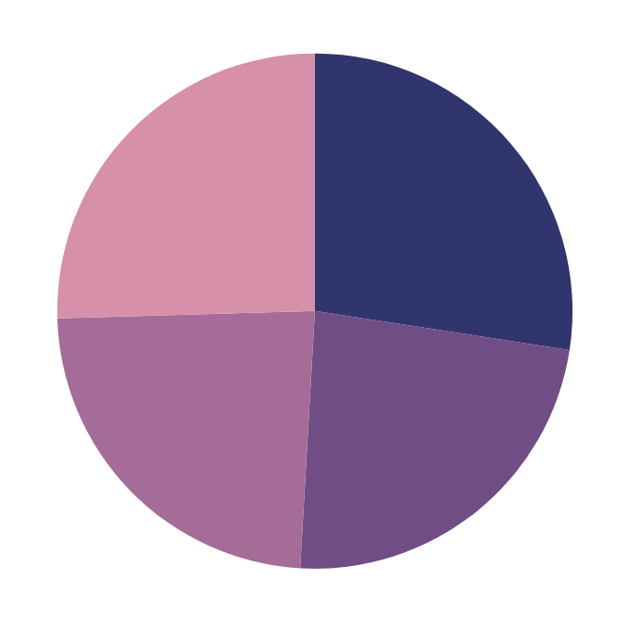
EV CHARGING PATTERNS BY TIME OF DAY 2024
MORNING
EVENING
High activity, as users charge at home or work to start the day.
Peak charging time, likely as people return home after work.
+15%
+12%
NIGHT
AFTERNOON
Common for overnight charging schedules.
Lowest activity, but close to nighttime levels.
-10%
-8%

Slide 4


ENERGY CONSUMPTION INSIGHTS
Energy consumption remains stable across temperatures with occasional spikes, while Level 1 show the highest energy use with but lowest charging costs.
Energy Consumed (kWh)
Energy Consumed (kWh)
Charging Cost ($ per kWh))
Temperature ( °C )
Charger Type

Slide 5




MALE USERS
FEMALE USERS
EV CHARGING STATIONS
Men represent the majority, with around 72% of EV registrations.
Women account for around 28% of EV registration.
EV CHARGING STATIONS
+12K
In 2024, an average of 12,000 new EV charging stations are added.

Slide 6





EV CHARGER PATTERN
MISSION
CLIENT
Facilitate sustainable transportation through convenient, accessible charging that curbs fossil fuel dependence and reduces greenhouse gas emissions.
Financially secure, family-oriented men , sustainable solutions that complement their lifestyle
EVERY
ASPECT
STARTUP
VISION
Accelerates EV adoption through accessible, user-friendly charging solutions that support sustainable transportation
Create a world where clean, accessible, and sustainable mobility is the norm.

Slide 7
Cansu Guzel
THANKS FOR WATCHING

